Slide 1


What’s it all about…EULA?
Talk 7
Part B “Connecting”
Video Game Law 2014
UBC Law @ Allard Hall
Jon Festinger Q.C.
Centre for Digital Media
Festinger Law & Strategy
http://videogame.law.ubc.ca
@gamebizlaw
jon_festinger@thecdm.ca

Slide 2
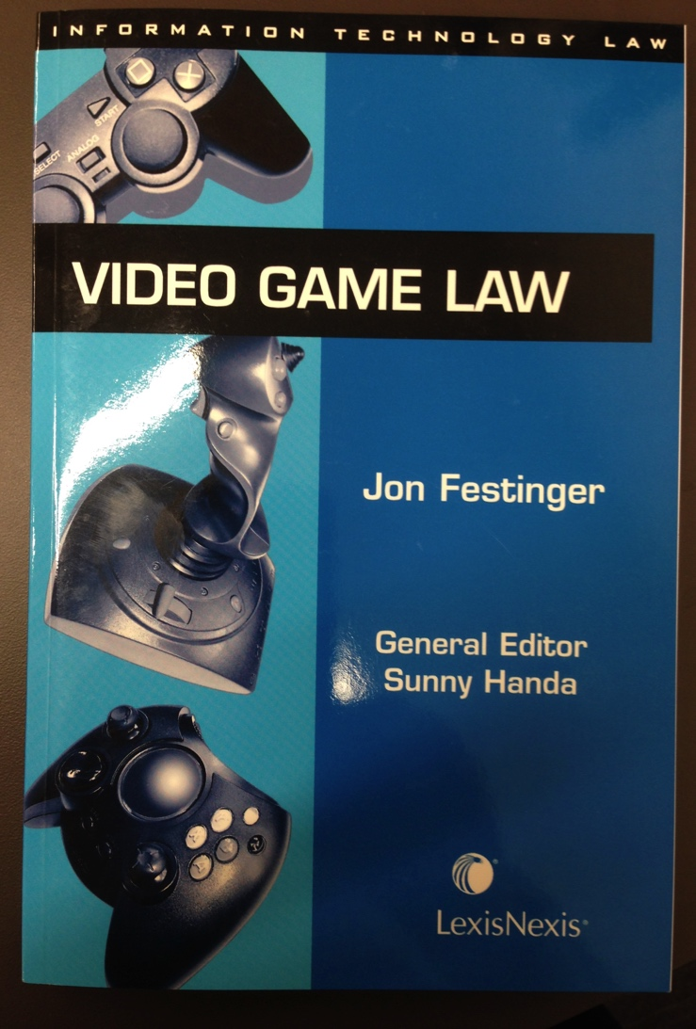
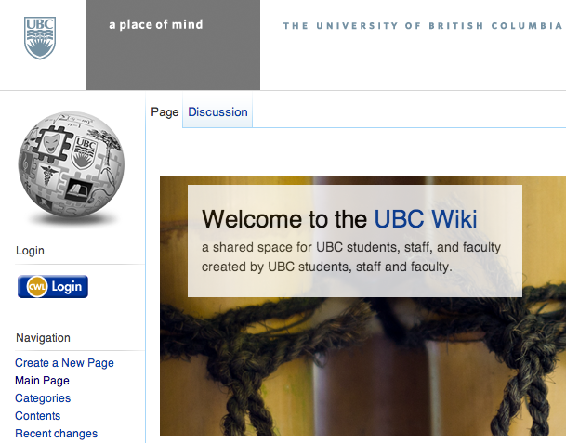
Wiki/Book Update
http://wiki.ubc.ca/Main_Page

Slide 3
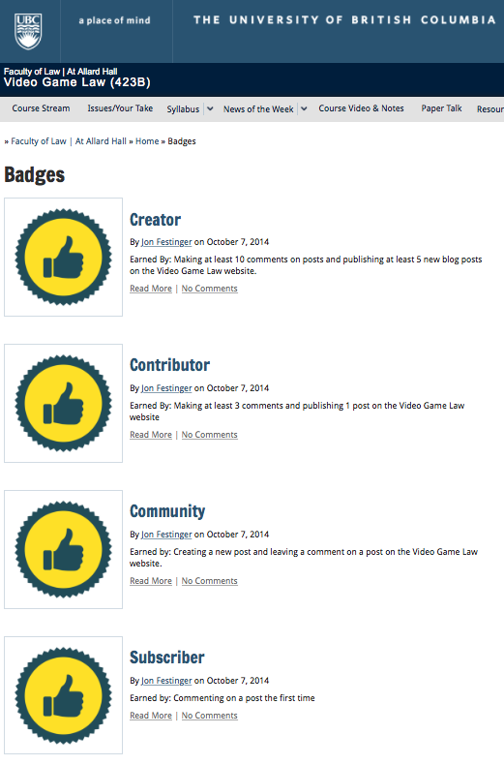

UBC Badges Project Update
Started last week – badges are flowing
Not retroactive
Working on a post & F.A.Q. with more information
http://badges.open.ubc.ca/
http://videogame.law.ubc.ca/badges

Slide 4
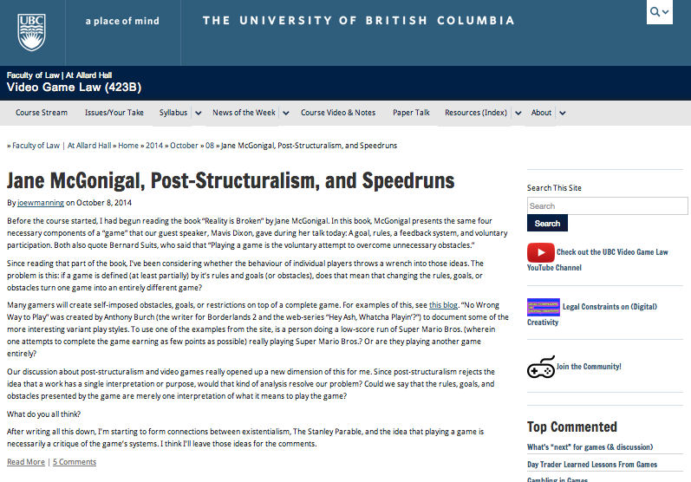
Post-Structuralism (con’d)

Slide 5
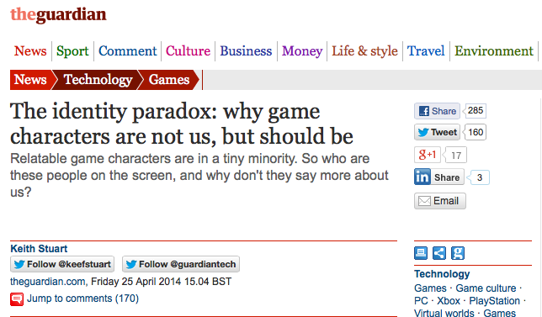
Conversations with (Dr.) Kim (Voll)
http://www.theguardian.com/technology/2014/apr/24/the-identity-paradox-why-game-characters-are-not-but-should-be

Slide 6
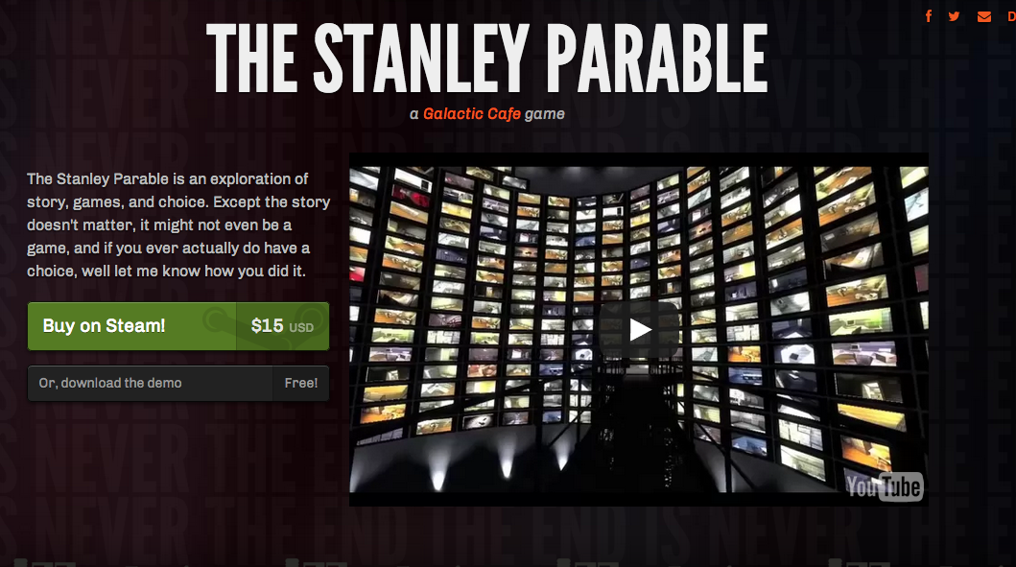
Recurring Conversations with Kim
http://www.stanleyparable.com/

Slide 7
Taking Stock: Where Are We?
Part A: Memes of “Creating”
Meaning & purpose of creating (in a video game context)
Right to CREAte (mod)
Games as social reaction (McLuhan)
Games as empty vessels (Boyden)
Role of the “Magic Circle”?
Copyright as power & constraint

Slide 8
Taking Stock: Where Are We? (2)
Part B: Memes of “Connecting”
How connecting creativity transforms and restrains it
Creation as Connection: Connection as both the cause & the purpose of Creation = Games are post-structuralist
Video-games (like all creative works) as merger of Creativity & Connection of both Developer/Creator & Player/Creator
Connections→Creation→Greater Connections→Legal implications of post-structuralist nature of games

Slide 9
Remember Copyright as part of the DEMOCRATIZATION OF THOUGHT?
* {KING..} Star Chamber (UK) abolished July 1641 - de facto cessation of
censorship;
* {TO PARLIAMENT..} replacement of Royal with Parliamentary censorship.
* {TO REGULATOR/EXCLUSIVE GUILD..} Licensing Order of 1643: Parliament required authors to have a government license before a work could be published. Restrictions enforced by the Stationers’ Company, a printers guild with the exclusive power to print - and the responsibility to censor - literary works – in return for monopoly on the printing trade.
* “Areopagitica”: “A speech of Mr. John Milton for the Liberty of
Unlicensed Printing to the Parliament of England”; 1644.
* “Licensing of the Press Act 1662”; "An Act for preventing the
frequent Abuses in printing seditious treasonable and unlicensed Bookes
and Pamphlets and for regulating of Printing and Printing Presses.”
* Then {TO PUBLISHERS/AUTHORS..} “The Statute of Anne” 1710 moved control to the publishers/authors…

Slide 10
Some more clues for the
“Trajectory of Freedom” theory
THE RIDDLE: Did the evolution of a separate right to freedom of speech/expression result in the recasting of “authors rights” into a property right?
*Statute of Anne (copyright) 1710.
*Declaration of the Rights of Man (French Revolution
providing for free speech for the common man) 1789/1793.
“Timeline: a history of free speech”
http://www.theguardian.com/media/2006/feb/05/religion.news
THESIS STATED:
1. FREE SPEECH TO AUTHORS WAS COPYRIGHT!
2. THEN COPYRIGHT BECAME MORE INFUSED BY
“PROPERTY” TO GIVE IT MEANING AS FREEDOM
OF EXPRESSION EVOLVED.

Slide 11
Leading to “THE POST IP WORLD”?
* Talks 5 & 6: Does the dominance of contracts mean we are already in a “The Post IP World”??
* Focus on contractual restraints (digital re-sale; transferability by will, contracting out of IP law permissions e.g. ToS prohibitions of reverse engineering)
CREATION goes with COPYRIGHT/IP LAW
CONNECTING goes with CONTRACT LAW

Slide 12
Nasty Questions:
Has the trajectory of copyright freedoms/uncertainties led to a contractual backlash?
Does copyright matter in a “Post IP World”?
Do freedoms exist outside of contract in a “Post IP World”?

Slide 13

Today
An assessment of the utility
of EULA’s (etc.)

Slide 14
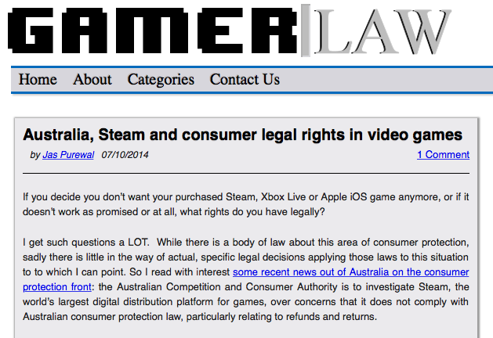
THINGS ARE CHANGING…
http://www.gamerlaw.co.uk/2014/australia-steam-and-consumer-legal-rights-in-video-games/

Slide 15
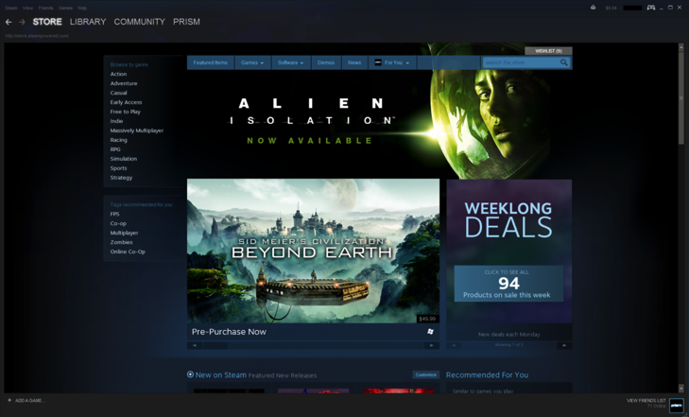
Jas Purewal: “This is a really interesting development to me for a few reasons: This is the first regulator to my knowledge which is specifically investigating the topic of digital distribution platforms’ compliance with consumer protection law, particularly regarding issues like refund rights and the extent to which platforms are bound by legal rules that products must always meet minimum quality standards (eg a requirement called called ‘satisfactory quality’ or ‘acceptable quality’ in the UK and Commonwealth countries or ‘merchantable quality’ in the US, among other requirements).”

Slide 16
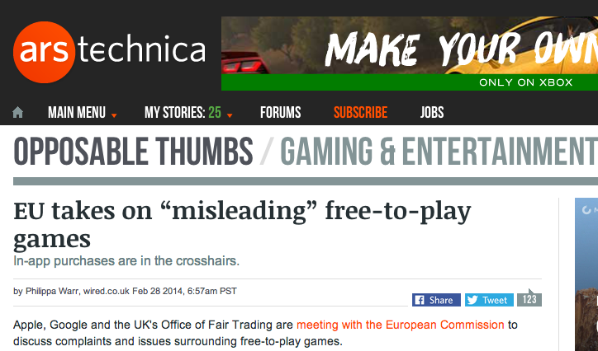
http://arstechnica.com/gaming/2014/02/eu-takes-on-misleading-free-to-play-games/

Slide 17
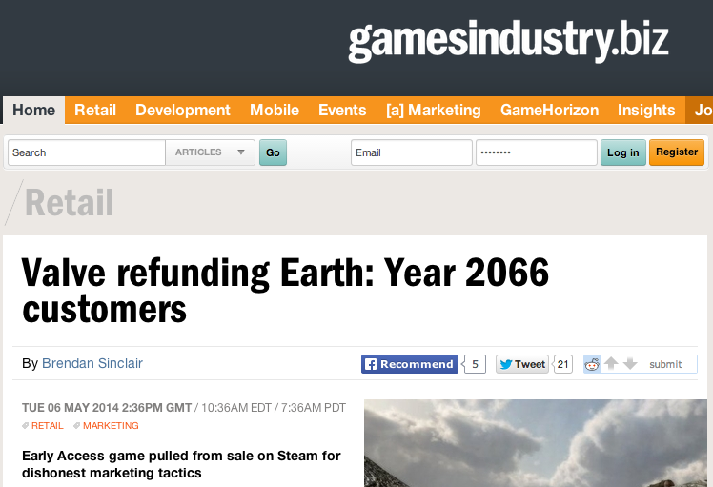
http://www.gamesindustry.biz/articles/2014-05-06-valve-refunding-earth-year-2066-customers

Slide 18
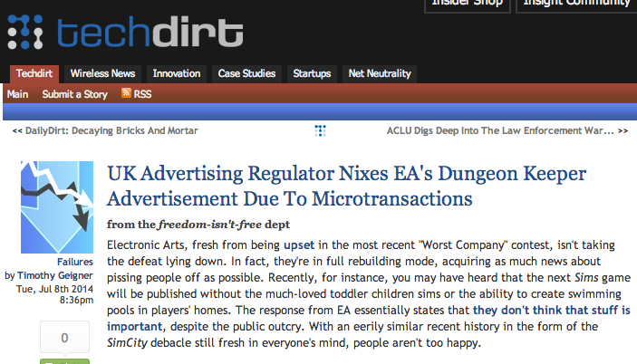
https://www.techdirt.com/articles/20140702/07443127757/uk-advertising-regulator-nixes-eas-dungeon-keeper-advertisement-due-to-microtransactions.shtml

Slide 19
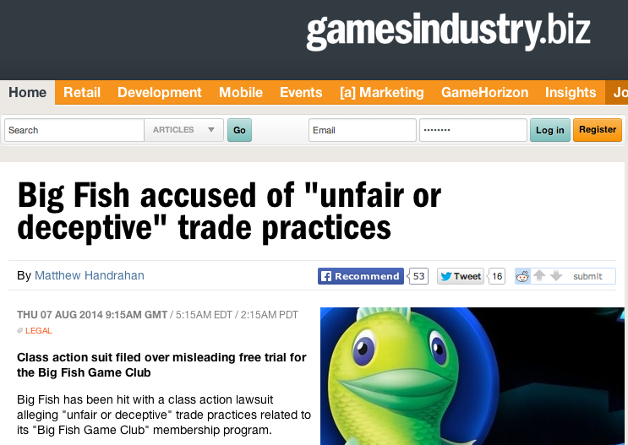
http://www.gamesindustry.biz/articles/2014-08-07-big-fish-accused-of-unfair-of-deceptive-trade-practices

Slide 20

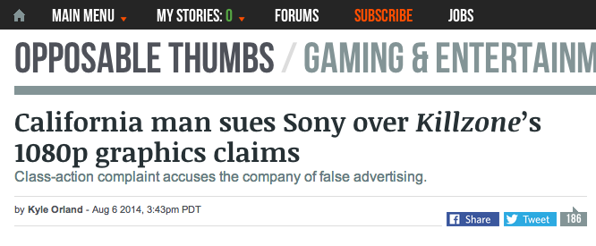
http://arstechnica.com/gaming/2014/08/california-man-sues-sony-over-killzones-1080p-graphics-claims/

Slide 21
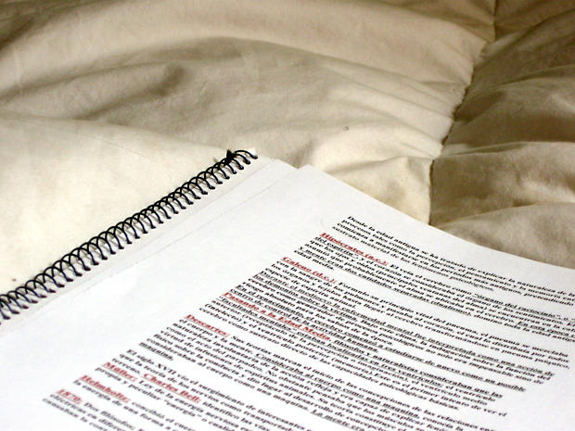
To more contractual issues…

Slide 22
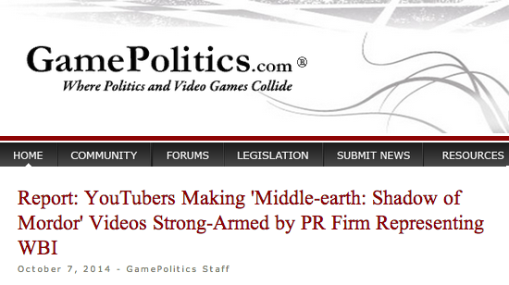
http://www.gamepolitics.com/2014/10/07/report-wb-strong-arms-shadow-mordor-reviewers#.VDxyXpRdX9Q

Slide 23
“YouTubers had to agree to do the following:
- Maximize awareness for the game during the ‘week of vengeance’
Persuade viewers to purchase game
Not show bugs or glitches that may exist
The agreement also notes that "videos will promote positive sentiment about the game.”
”…the company has final approval on the YouTube video at least 48 hours before any video goes live,”
Those who didn't sign the "branding agreement" and made their own found their videos taken down by a YouTube ContentID claim” (Abuse of copyright law?)

Slide 24

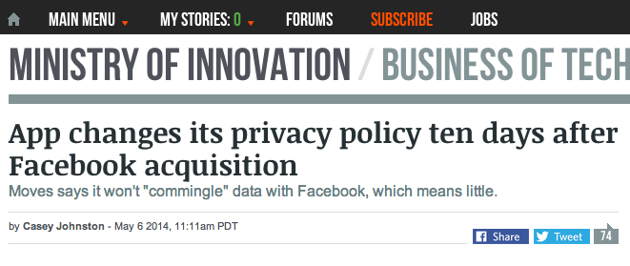
http://arstechnica.com/business/2014/05/app-changes-its-privacy-policy-ten-days-after-facebook-acquisition/

Slide 25

To understand EULA’s…

Slide 26
Constraint/Restraint - Coercion/Control
con·strain/kənˈstrān/Verb
Severely restrict the scope, extent, or activity of.
Compel or force (someone) toward a particular course of action.
Synonyms: force - compel - coerce - oblige - necessitate
re·strain/riˈstrān/Verb
Prevent (someone or something) from doing something; keep
under control.
Prevent oneself from displaying or giving way to a strong
urge or emotion.
Synonyms: curb - check - hold - repress - control - contain

Slide 27
A Pattern?
CREATION goes with COPYRIGHT/IP LAW
CONNECTING goes with CONTRACT LAW
BECOMES
COPYRIGHT/IP LAW CONSTRAINS CREATION
CONTRACT LAW RESTRAINS CONNECTING

Slide 28
Emerging from Talk 6 (“10 Cases -..”)
Copyright - serious consequences (injunctions, fines)/serious defenses
(fair use/dealing) = constraint oriented
Contract - less serious/few defenses (generally damages only)
= restraint oriented
Cases – (vaguely) consumer/user rights (constraint) oriented
Considering:
1. Companies draft; consumers don’t
2. Click-wrap “fiction”
3. Lack of standardization (Industry Assoc./Treaty/Consumer Protection)
4. All cases had multiple causes of action, not just contract
Query: Morality of contracting out of:
a.) free speech/expression rights
b.) prevailing statutory copyright laws/rights
c.) {& we have not even mentioned privacy yet}

Slide 29
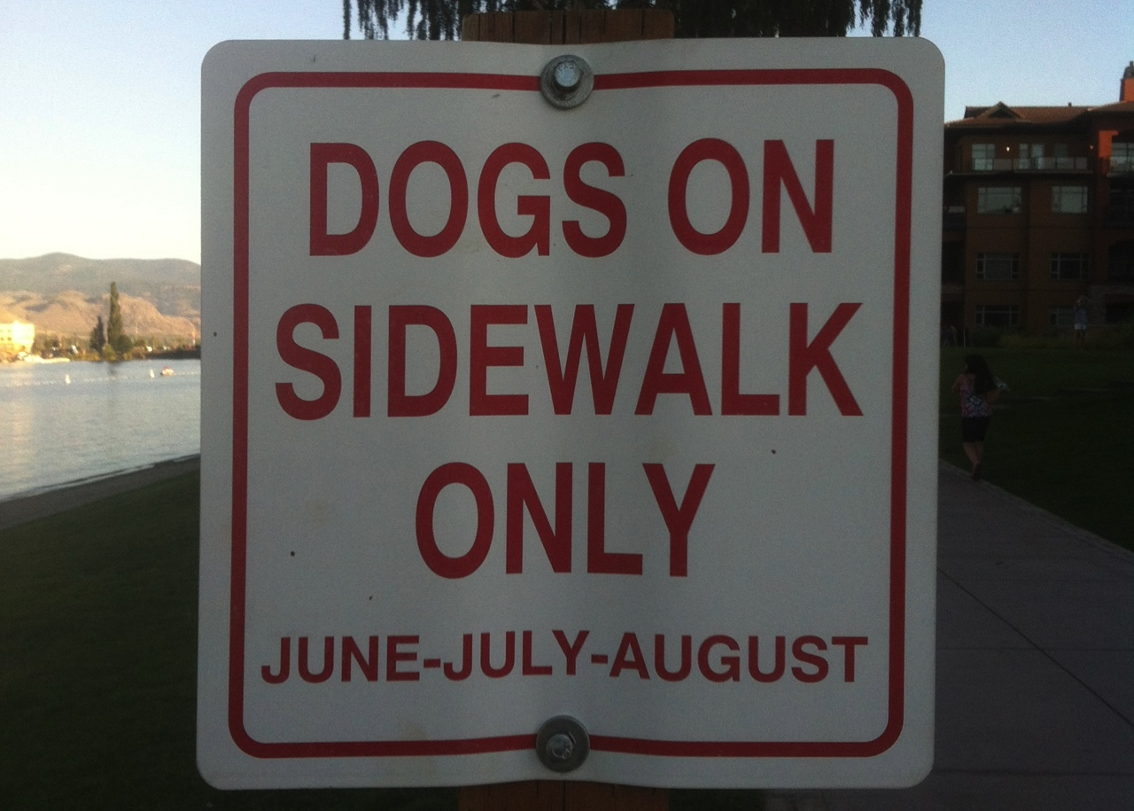
The problem with drafting…
(Where do the humans go?)

Slide 30
Trends in the Cases?
COPYRIGHT (constraint)
to
USER RIGHTS
(e.g. reverse engineering, fair use, right to create {?})
to
CONTRACTING (restraint)
to
REMOVING USER RIGHTS
(no reverse engineering, no mods, no privacy?)
to
RE-EMERGEANCE OF USER RIGHTS ???
(same user rights as copyright? – BUT HOW?)
*Fairness of this process of moving from constraints to
additional restraints without user understanding?

Slide 31

Double Standard Tests
Core problem: EULA’s, ToS’ etc. we “agree to” are all different in specifics; yet apply to billions of people.
DOUBLE STANDARD Test #1: since digital developers Can (& do) customize your content, Why not YOUR EULA, TOS & Privacy agreements?
DOUBLE STANDARD Test #2: How many developers could survive the terms they impose on Consumers?
ETHICAL SOLUTION?: Embedding a “Do Unto
Others” algorithm rule-set which permits us to use the
digital bits of others if we share ours to the same
standard. Barter not infringement.

Slide 32
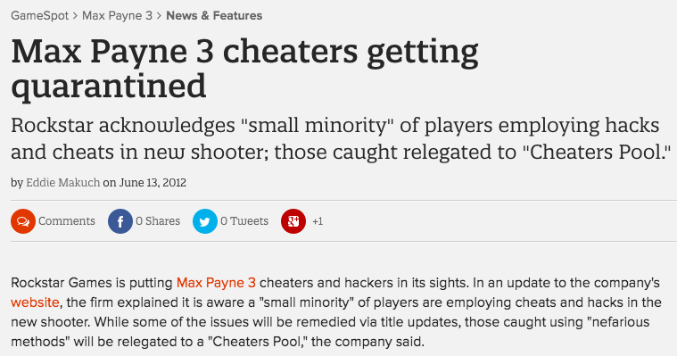
Why not tailor our rights in terms of how we deal with the rights of others?
http://www.gamespot.com/articles/max-payne-3-cheaters-getting-quarantined/1100-6382313/

Slide 33
Query: Developer’s Liability - Are not EULA/
ToS’ needed for the “really bad” stuff?
* Would a short legal notice would be as effective as EULA/ToS?
“Cheating, illegal &/or intolerant behavior is not acceptable. In such event we may take such legal or other actions we deem appropriate in our sole discretion.”
* EULA cases do tend to relate to commercial threats, not “really bad” stuff. See Davidson & iRacing for example.
* Bot/gold-mining cases more ambiguous, being about both;
a) gamer's experience; &
b) company possibly offering gamer same features.
* Consider: Blizzard Entertainment, Inc. v. In Game Dollar, LLC,
USDC Cal.2007 (gold-farming) followed by “Blizzard Introduces Buying in-Game WoW Items” (Nov/09)http://www.tomshardware.com/news/World-Warcraft-Blizzard-MMORPG-Microtransactions,9003.html

Slide 34
A More Insidious Result?
Censorship controls effectively delegated to private interests (without free speech/expression overrides).
* “Apple rejects game based on Syrian civil war”http://killscreendaily.com/articles/news/apple-rejects-game-based-syrian-civil-war/
* “iOS games chafe under Apple's directions: 'If you want to criticize a religion, write a book’”http://www.theverge.com/2013/1/16/3879194/apple-app-store-guidelines-tell-game-developers-to-avoid-serious-themes
* “Turns Out Sexist Talk on Xbox Live Won't Earn You a Lifetime Ban” – but racist talk will.http://www.gamepolitics.com/2012/11/07/turns-out-sexist-talk-xbox-live-wont-earn-you-lifetime-ban#.URsttVpAR3c
* & less insidiously: “Blizzard Bans 'Several Thousand' Diablo III Players for Cheating” – using bots (Would “Notice” do?)http://gamepolitics.com/2012/12/19/blizzard-bans-several-thousand-diablo-iii-players-cheating#.URswDFpAR3c

Slide 35
…but the “functional” answer may be…
Causes of action other then violation of EULA
& ToU available in ALL relevant cases…
1. Davidson & Associates, Inc. v. Internet Gateway:
Breach of Digital Millennium Copyright Act (DMCA) found.
2. Blizzard Entertainment, Inc. v. In Game Dollar, LLC:
Claims of intentional interference with contract; unfair competition & unjust enrichment. Case settled.
3. MDY Industries, LLC v. Blizzard Entertainment, Inc.:
Breach of DMCA found.
4. Blizzard Entertainment, Inc. v. Marshall:
Claims of copyright infringement, circumvention of copyright protection systems in violation of the DMCA & tortious interference with contract. Case dropped (settled).
5. iRacing Motorsports Simulations, LLC v. Tim Robinson: Copyright infringement found.

Slide 36
Proof of non-EULA claims in EULA cases 2
6. Zynga Game Network, Inc. v. Labrasca: Claims of
trademark infringement, unfair competition, passing off, and
intentional interference with contractual relations. Consent
judgment.
7. Evony, LLC et. al. v. Holland:
Default judgment based on copyright infringement
(Copyright Act & DMCA), trademark & trade dress
infringements, tortious interference with contractual
relations & prospective economic advantage.
Footnotes - other cases not on-point
8. Vernor v. Autodesk, Inc.: Judgment for copyright infringement (non-game case).
9. Smallwood v. NCSOFT: EULA as defense in gaming addiction case not fully upheld
10. Hernandez v. Internet Gaming Entertainment, Ltd: Action by gamer against
gold farming company seeking to use ToU & EULA gold farming company must have
agreed to. Settled.

Slide 37

The Heretical Question…
Are EULA’s & ToS’ even necessary?

Slide 38
Unfairness?
1. Un-contract like uncertainty: Termination clauses that aren’t….eg. WoW EULA:
“This License Agreement is effective until terminated. You may terminate the License Agreement at any time by (i) permanently destroying all copies of the Game in your possession or control; (ii) removing the Game Client from your hard drive; and (iii) notifying Blizzard of your intention to terminate this License Agreement. Blizzard may terminate this Agreement at any time for any reason or no reason.”
Are we party to hundreds of contracts (or more) we don’t use?

Slide 39
Unfairness? (con’d)
2. Average Privacy Policy Reading Level is that of a College
Sophomore while Average U.S. Reading Level is 8th Grade.
“Examination Of Privacy Policies Shows A Few Troubling Trends”
http://techcrunch.com/2011/11/30/examination-of-privacy-policies-shows-a-few-troubling-trends/
3. “Microsoft Attacks Google on Gmail Privacy” | NY Times
“The ads will showcase research that shows most people don’t know that Web e-mail providers like Google scan the contents of their e-mail messages to deliver personalized ads to them — and when they do find out, they don’t like it.”
http://bits.blogs.nytimes.com/2013/02/06/microsoft-attacks-google-on-gmail-privacy/
4. “Terms of Service: Didn’t Read” (website) “I have read and agree to the Terms” is the biggest lie on the web. We aim to fix that.” http://tos-dr.info

Slide 40

The Common Law explains itself
“Every expression of a common intention arrived at by the parties is ultimately reducible to question and answer.” Anson, Principles of the English Law of Contract, 2nd Edn., p.15 (1882).
Common Law is ‘concerned not with the presence of an inward and mental assent but with its outward and visible signs.” Cheshire and Fifoot’s Law of Contract, 9th Edn. P.26 (1976).
…not much comfort…
…when there is an
obvious issue?

Slide 41
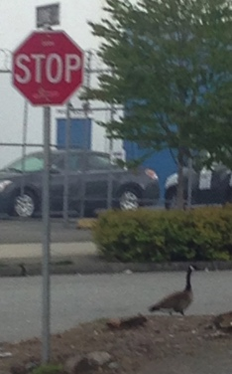
Roads to explore…
To Re-ask the question: Are consumer contracts/license agreements redundant &/or unnecessary?
If EULA’s, ToS, & (non) Privacy Agreements disappeared suddenly would the gaps be filled by:
* Copyright
* Competition-antitrust law
* Privacy law
* Consumer protection laws
* International law/treaties
* Legislation & regulation
See: “Peer Progress and Regulation 2.0” Nick Grossman on principles of regulation in the digital networked age
https://citp.princeton.edu/event/grossman/ (video)
http://www.avc.com/a_vc/2013/02/peer-progress-and-regulation-20.html (slides)

Slide 42
Other Alternatives
1. Market uprising: e.g. “Instagram’s revised terms of use: Will the Facebook generation fight back?” http://www.lexology.com/library/detail.aspx?g=d3ce96bc-2b40-4c0c-8a36-c855e6f2207e
2. Technology (DRM+): e.g. “Examining Sony's Internet-free method for blocking used game sales”: “…patent application…outlines a content protection system that would use small RFID chips embedded on game discs to prevent used games from being played on its systems, all without requiring an online connection.” http://arstechnica.com/gaming/2013/01/examining-sonys-internet-free-method-for-blocking-used-game-sales/

Slide 43
The Future?
“The privacy policy required by this section shall be no more than 100 words and shall be written in clear and concise language at no greater than an eighth grade reading level. The privacy policy shall include a statement indicating whether the personally identifiable information may be sold or shared with others, and if line so, how and with whom the information may be shared.”
Context: Act amends Section 22575 of the Business and Professions Code, which requires that an operator of a commercial Web site or online service operators collecting personal information about consumers to make its privacy policy available.
California BILL No. 242; Assembly Member Ed Chau - February 6, 2013 (BILL No. 242 was 336 words per Techdirt) http://www.leginfo.ca.gov/pub/13-14/bill/asm/ab_0201-0250/ab_242_bill_20130206_introduced.pdf

Slide 44
Further Reading
1. “Empirical studies on software notices to inform policy makers and usability designers”; Jens Grossklags, Nathan Good (University of California Berkeley, 2007)
“Abstract: We evaluate the usability of End User License Agreements (EULAs) of popular consumer programs. Results from an empirical evaluation of 50 popular programs show the lack of accessibility and readability of notices. Our data from a recent study with 64 users involved in installation tasks confirms the public perception that notice to and consent by the user is not achieved.”
http://people.ischool.berkeley.edu/~jensg/research/usec.html
2. “Examination Of Privacy Policies Shows A Few Troubling Trends” (2011)
http://techcrunch.com/2011/11/30/examination-of-privacy-policies-shows-a-few-troubling-trends/

Slide 45
Further Reading 2
3. “Intellectual Property and Shrinkwrap Licenses”; Mark Lemley (1995)
http://papers.ssrn.com/sol3/papers.cfm?abstract_id=2126845##
4. “Terms Of Service, Terms Of Play In Children’s Online
Gaming”; Sara Grimes (2007)
http://www.academia.edu/183319/
Terms_Of_Service_Terms_Of_Play_In_Childrens_Online_Gaming
5. “Confess and protest against the Biggest Lie!”
http://www.biggestlie.com
6. “The Cost of Reading Privacy Policies”; A. McDonald, L.
Cranor. 4 ISJLP 543 (2008-2009)
http://lorrie.cranor.org/pubs/readingPolicyCost-authorDraft.pdf

Slide 46
Further Reading 3
7. “Re-Mediating Research Rthics: End-User License Agreements in Online Games”; Florence Chee, Nicholas Taylor, and Suzanne de Castell (2012) http://www.academia.edu/2976765/Re-Mediating_Research_Ethics_End-User_License_Agreements_in_Online_Games
8. “CLICK AND COPY: BREACH OF ONLINE LICENCE AGREEMENTS AND COPYRIGHT INFRINGEMENT”; Richard Stobbe (2012) 28 C.I.P.R. 227
http://www.ipblog.ca/wp-content/uploads/2013/01/cipr-28-2-click-and-copy-breach-of-
online-license-agreements-and-copyright-infringement-c1380000.PDF
9. “Top EULA Gotchas: Website Fine-Print Hall of Shame” (2012) http://www.pcworld.com/article/249396/top_eula_gotchas_website_fine_print_hall_of_shame.html
10. “Living and Dying in a Virtual World: Estate Planning or Digital Assets”; Greg Lastowka & Trisha Hall (2013) http://lastowka.rutgers.edu/files/2013/10/Lastowka.pdf
11. “Face value: digging through Google’s clumsy new terms of service” (2013) http://www.theverge.com/2013/10/17/4845828/digging-through-new-google-terms-of-service

Slide 47
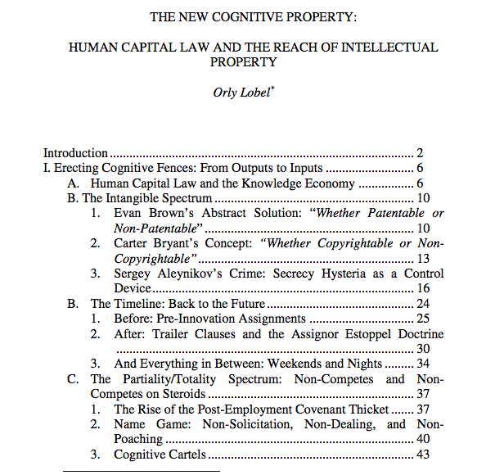
One last thought on contracts as restraints…
http://www.law.berkeley.edu/files/Lobel_Orly_IPSC_paper_2014.pdf

Slide 48


Silicon Valley, Boston &
Restrictive Covenants

Slide 49
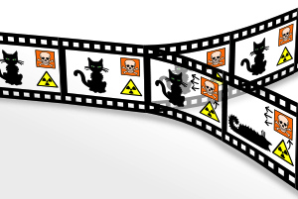
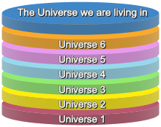
The Post IP World Considered
Two vastly different versions:
Post IP World A =
Contracts that super-cede rendering IP all but irrelevant {where we are?}
Post IP World B = User Rights + standard formatted, treaty based and/or consumer protected minimalist contracts {where we are not}

Slide 50
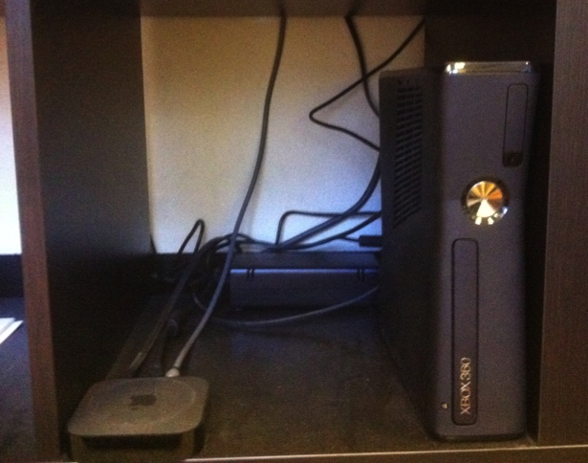
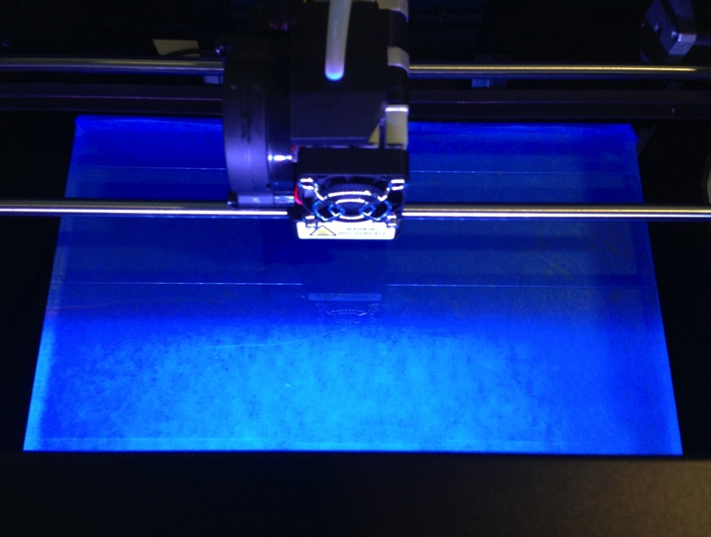

NEXT TIME….
FROM WHEELBARROWS TO HOLODECKS: “CONNECTING” LIVING ROOMS…THINGS…MOBILE DEVICES…EACH OTHER…AND WAY BEYOND…ON THE LEGAL IMPLICATIONS OF CONVERGEANCE…

Slide 51
In anticipation (1):
Consider the Question
WHY DOES LAW SEEM TO RESPOND SO SLOWLY TO TECHNOLOGICAL CHANGE?

Slide 52
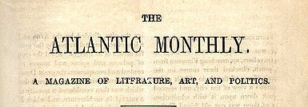

“When Does Technology Change Enough That the Law Should Too?
Today's lower court ruling deferred to the Supreme Court's 1979 decision, Smith v. Maryland. Should that case still matter?
REBECCA J. ROSEN
DEC 27 2013, 5:39 PM ET”
“The Atlantic” on the
constitutionality of
NSA surveillance

Slide 53

In the coming of the Digital world
the Law often seems behind,
disconnected and confused,
incapable or too slow to do
Justice..
“[s]tealing is stealing whether you use a computer command
or a crowbar, and whether you take documents, data or
dollars. It is equally harmful to the victim whether you
sell what you have stolen or give it away.”*
*The United States Attorney’s Office, District of Massachusetts, Press Release, “Alleged Hacker Charged with
Stealing over Four Million Documents from MIT Network” (19 July 2011), online:
http://www.justice.gov/usao/ma/news/2011/July/SwartzAaronPR.html>

Slide 54
Consider the possibility...
…that concepts of Law & Justice
can never adequately resolve
issues related to communications
because…
communications memes
proactively define the future
meanings of Justice & the forms
Law will take.

Slide 55
Put Another Way…
Communication tools iteratively alter and shape how and what we communicate, including (over time) how we formulate ethical concerns and legal frameworks…

Slide 56
Technology /Justice (Parallels)?
Before Justice was Revenge
1. Pre-literate => Justice as Retribution
2. Writing Instruments =>Justice as Compensation
3. Printing Press => Justice as Rights
4. Mass Media => Justice as Truth
5. Digital => Justice as Resolution
6. Big Data=>Justice as (Individual) Boundaries
7. Virtual reality => ???

Slide 57

& just so you have something to ponder in anticipation (2)…
“ARE YOU LIVING IN A COMPUTER
SIMULATION?” Nick Bostrom – Faculty of
Philosophy, Oxford University. http://www.simulation-argument.com/simulation.html
“Physicists devise test to see if we're living in
'The Matrix”http://www.theverge.com/2012/10/11/3487710/computer-simulation-silas-beane-university-bonn
WE ARE ?

Slide 58

Always include a cat picture

Slide 59
Our Academic Partners

