Slide 2
Who is Brian?
Called to the Bar in March 1998
At EA - Responsible for the oversight and management of the legal team in Canada and the delivery of legal services to the Canadian operations.
The Canadian legal team consists of three lawyers, a paralegal, an immigration specialist and an administrative assistant. Supported by a much larger legal team based in Redwood Shores, California

Slide 3
EA AND CANADA
Operate in 5 Provinces – BC, AB, ONT, QUE and PEI
Have over 2000 full time employees
Burnaby Studio is one of the largest game development studios in the world

Slide 4
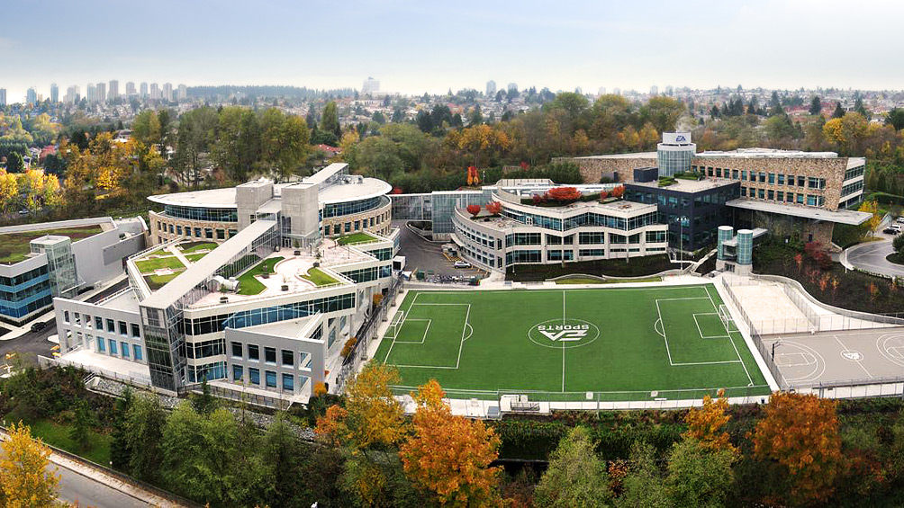

Slide 5
WHAT BRIAN DOES ALL DAY
*As imagined by my family, friends, neighbours, and former law firm friends

Slide 6
WHAT BRIAN DOES ALL DAY

Slide 7
LEGAL NEEDS …
Video Game companies … are … companies
The legal needs of EA are in many respects no different than those at any large, publicly traded, multi-national corporation

Slide 8
Groups that make up EA Legal worldwide
EA Legal
IP Policy/Practice
Team
Business Affairs
Team
Corporate Groups
Legal Support
Team
Intellectual Property
Enforcement Team
Legal Approvals/
Intellectual Property
Protection Team
Licensing Team
Privacy Team
Mergers &
Acquisitions Team
Stock Administration
Team

Slide 9
Licensing (Transaction) Teams
Provide support and expertise to studio and procurement teams, product development teams (both online and packaged-goods) and marketing teams to draft, review, negotiate and interpret technology licenses entertainment industry and celebrity licenses, sports league and athlete endorsement agreements, third-party product development agreements, content licenses, marketing/promotion agreements, consulting agreements, etc.
In Canada the Transaction Team works with the following key franchises:
NHL, NBA, FIFA, Need for Speed, UFC

Slide 10
IP Protection Team
Patents, Trademarks, IP Enforcement Issues, IP related litigation, Patent Infringement, Copyright Infringement
Responsible for many aspects related to the use of EA’s intellectual property, as well as that of EA’s licensors.
Includes review of all game related materials, promotions, trademark clearances, permission requests, etc.
Responsible for many aspects related to the use of EA’s intellectual property, as well as that of EA’s licensors.
Includes review of all game related materials, promotions, trademark clearances, permission requests, etc.

Slide 11
Privacy Team Provide privacy policy compliance and data protection guidelines
This is rapidly becoming a major part of the legal team’s role within EA
Privacy breaches or lapses can have devastating consequences for the business and the ability to provide rapid and accurate advice is critical
Eg. Sony’s PlayStation Network was breached in 2011 and resulted in a total shutdown of the service with both a financial cost and damage to the brand

Slide 12
Stock Administration Team
Responsible for processing stock option and ESPP transactions, SEC compliance including stock reporting and reconciliation.
Mergers & Acquisitions Team
Advice and counsel with respect to EA’s acquisitions, investments and other strategic corporate transactions.
Key acquisitions:
BioWare – 2008
PopCap – 2011
2 Strategtic Canadian acquisitions in PEI in 2011 and 2012

Slide 13
Business Affairs Team
→ Provide counsel to studios on a wide range of production-related issues, with heavy emphasis on business issues related to development and talent deals, and acquisition and licensing third-party content.
Inbound licenses (assets, technology)
External development (full games, lower cost development)
Platform licenses (Msft, Sony, Apple, Nintendo)
Online Distribution (FIFA Online, NFS)
Emerging Technologies (streaming, Smart TV)

Slide 14
Corporate Groups - Legal Support
Legal counsel and support is provided to all EA Corporate Groups, including Corporate Services, Facilities, Finance, Human Resources, IT, Operations and Retail Sales
Represents the bulk of non-IP/game related work

Slide 15
Key Corporate Services- Employment
Employment/Consulting Contracts
HR Policies
Compensation and Benefits (ESPP; RRSP Matching Program; Equity Incentive Programs)
Hiring, Firing and Performance Management

Slide 16
Key Corporate Services - Immigration
EA sources and recruits top talent world wide
At any given time in Burnaby as many as 400+ employees will be foreign nationals working under work permits
The ability to easily access talent from abroad is critical and can often determine whether products are developed here or not

Slide 17
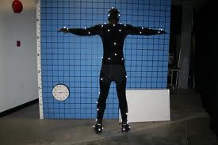
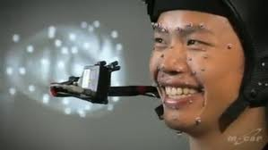
Key Corporate Services - Performers
Performers
EA uses a variety of performers
For motion capture, facial/likeness capture
For voice over work
For promotion or marketing purposes

Slide 18
Key Corporate Services – Facilities and IT
Facilities in all 5 Provinces
Combination of owned/leased
Lease agreements/amendments
Facilities and IT related contracts

Slide 19
Litigation
Employment related litigation
Wrongful dismissal / Employment Standards
Human Rights
WCB
IP Litigation
Not generally a Canadian issue
Other
Real estate, services or suppliers

Slide 20
The bottom line… Balancing Risk Against Reward
Managing risk vs eliminating risk
2 guiding principles:
Retain control over IP
Enable the business

Slide 21
QUESTIONS?

