Slide 1
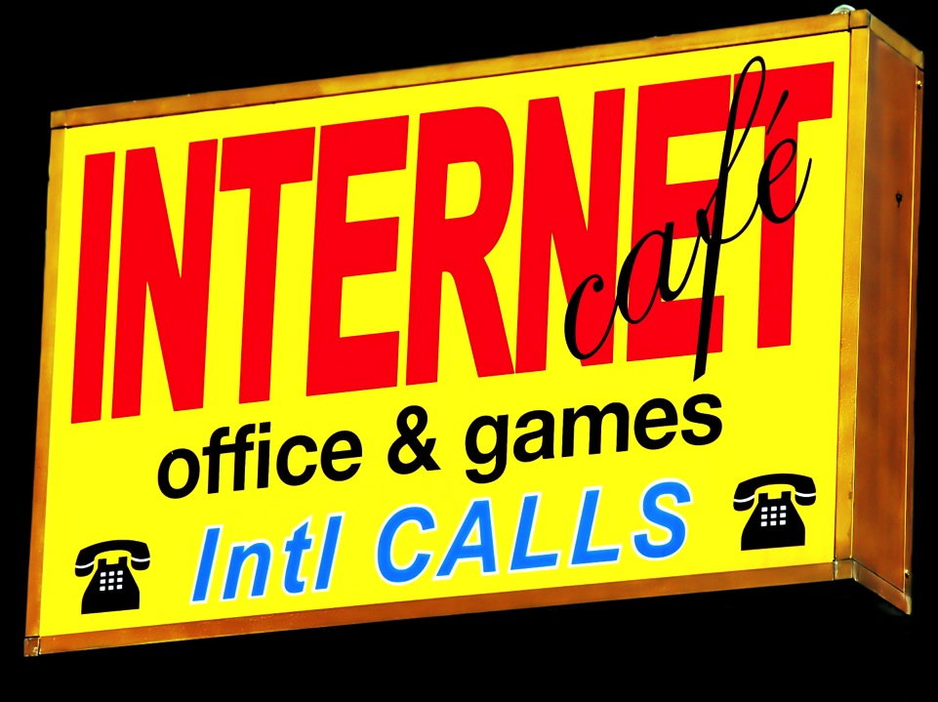

Social Media Memes & Legal Realities
“And Now For a Word…FROM the Audience.
Social Media: Disruption and Opportunity”
The Law Society of Upper Canada
17th Biennial National Conference
New Developments in Communications
Law and Policy, May 1 2014
Jon Festinger Q.C.
Festinger Law & Strategy
Centre for Digital Media
UBC Faculty of Law
TRU Faculty of Law
http://videogame.law.ubc.ca
@jonfestinger

Slide 2
Index
Introduction
What Do We Mean By “Social Media”
Environmental Scan
Challenging “Traditional” Media
Selling Facebook
A Brief Word About Measurement & Revenue Streams
Netflix, Big Data & Net Neutrality
Challenges & “Solutions
1. “Piracy”
2. Problems with “Solutions”
3. Copyright Literalism: Inadequate For Canada
I. Backlash
J. Some Answers For “Conventional” Media
K. Future Challenges
1. The Internet of Things
2. Facebook + Virtual Reality
The Challenge of “The Law”
Final Thoughts

Slide 3
A. Introduction

Slide 4
Panel Description
“Social media is an agile, immediate source of news, information, opinion and content. It has the ability to break down areas of interest more finely than the narrowest niche broadcast services. To what extent is social media displacing TV and radio as the “mass media middleman”? To what extent is social media enhancing “traditional” broadcasting, or even integrating into it? The CRTC has suggested that social media can be leveraged to help support its policy objectives. Is regulation far behind? This panel will look at how social media is changing the conversation, for broadcasters, their audiences, and the Commission.”

Slide 5
Purpose of this Document
To set out:
An overview of policy related issues
Legal perspectives where relevant
A few of my own questions

Slide 6
Un-orthodoxy of this Document…
To try and do all this is a pedagogically open world format*…
World of
LawyerCraft
*If you are really interested in what this means check out:
http://videogame.law.ubc.ca/2014/03/30/article-horrible-night/
http://videogame.law.ubc.ca/2014/03/24/bc-open-education-chat/

Slide 7
Memes…
“Just as genes propagate themselves in the gene pool by leaping from body to body via sperms or eggs, so memes propagate themselves in the meme pool by leaping from brain to brain.”
Richard Dawkins “The Selfish Gene” (Oxford University Press 1976)

Slide 8

"The world as we have created it is a process of our thinking. It cannot be changed without changing our thinking”
Albert Einstein

Slide 9
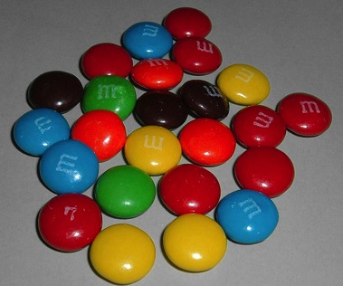

All A MATTER OF PERSPECTIVE

Slide 10
B. What Do We Mean By
“Social Media”

Slide 11
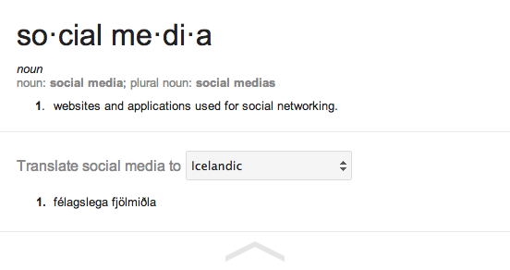
A Definition of Social Media
My definition: “ Social media is an interactive form of distributing (digital) communications incorporating user generated content.”

Slide 12
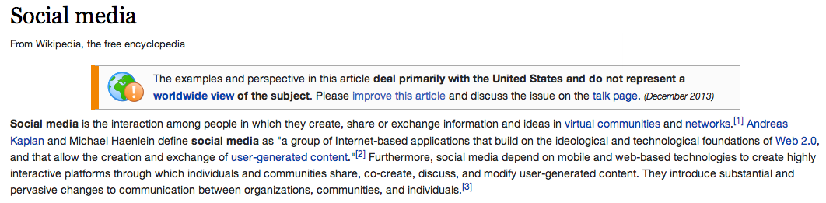










Slide 13
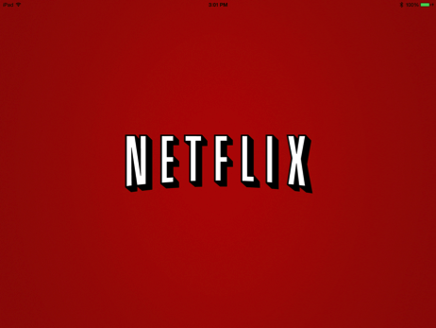





What About ?????

Slide 14
(TODAY) IN THE DIGITAL WORLD
idea
private
EXPRESSION*
PUBLIC
* implications for the idea/expression dichotomy in copyright law are for another day

Slide 15
C. Environmental Scan

Slide 16
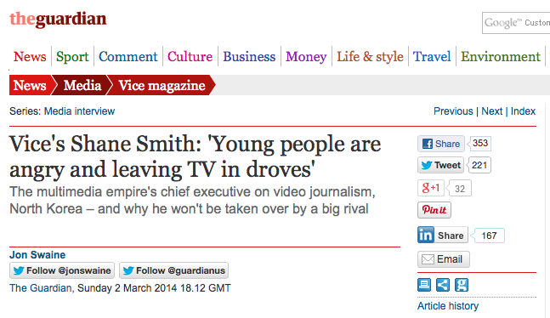

Slide 17
America’s most profitable media
& internet companies
Google $12.21 billion
Liberty Media Corp $8.99 billion
21stCentury Fox $7.32 billion
Walt Disney Co. $6.64 billion
Time Warner Inc. $3.69 billion
Viacom $2.44 billion
CBS Corp. $1.88 billion
Facebook $1.49 billion
Yahoo $1.37 billion
Omnicom $1.11 billion
Discovery Communications $1.08 billion
…………………………………………
Netflix $122 million
AOL $92 million
LinkedIn $29 million
………………………………………….
Twitter - $645 million
Source: Quartz /SNL Kagen
http://qz.com/193802/traditional-media-is-still-a-great-business-to-be-in-if-youre-selling-video/

Slide 18

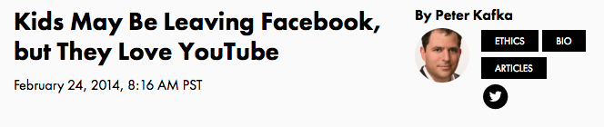
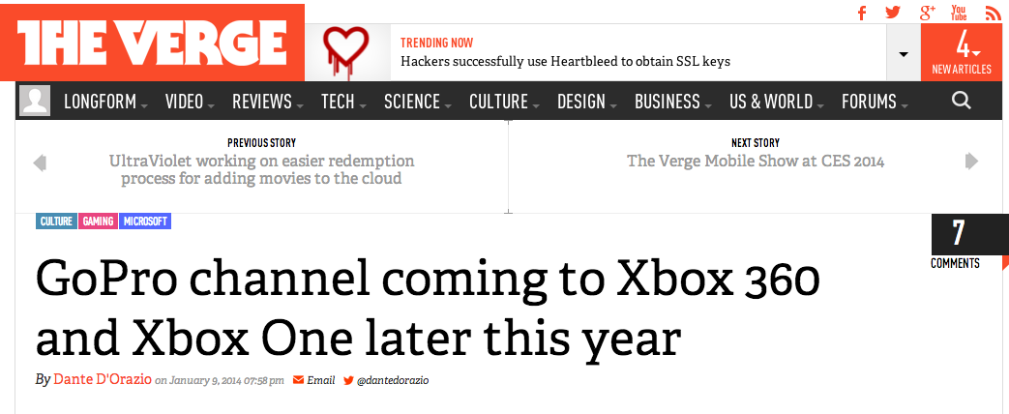

Slide 19
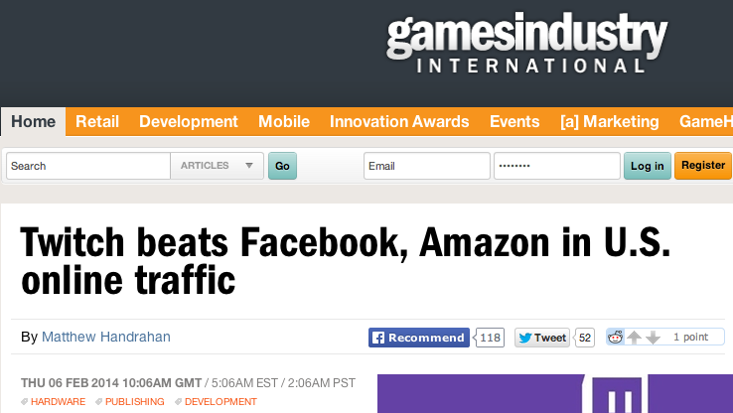
http://www.gamesindustry.biz/articles/2014-02-06-twitch-beats-facebook-amazon-in-u-s-online-traffic

Slide 20
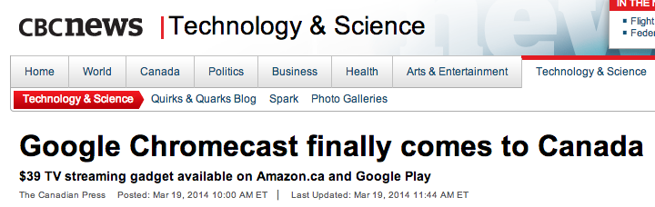


Slide 21

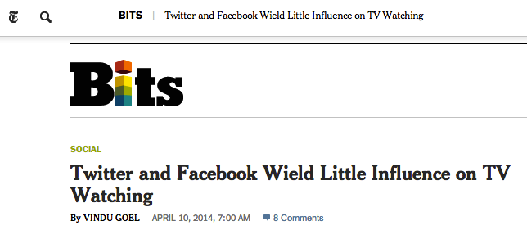
http://bits.blogs.nytimes.com/2014/04/10/twitter-and-facebook-wield-little-influence-on-tv-watching/?_php=true&_type=blogs&hpw&rref=technology&_r=0

Slide 22
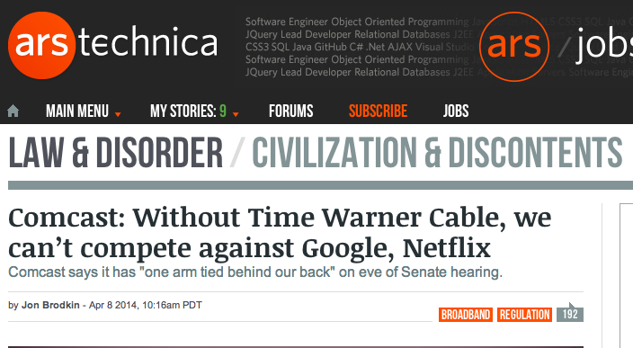
http://arstechnica.com/tech-policy/2014/04/comcast-without-time-warner-cable-we-cant-compete-against-google-netflix/

Slide 23

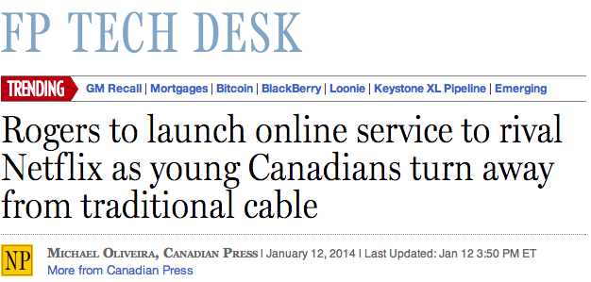
http://arstechnica.com/tech-policy/2014/04/comcast-without-time-warner-cable-we-cant-compete-against-google-netflix/

Slide 24

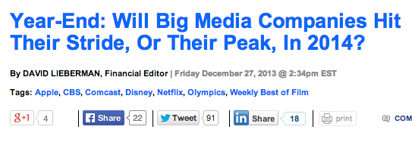
http://www.deadline.com/2013/12/big-media-2013-year-in-review/

Slide 25
D. Challenging Traditional Media

Slide 26
The Real Problem?
Could it be that for the first time ever, the national pop culture conversation, is happening outside of “traditional” media?
Adapted from “The Opt-Out Economy” by Daniel Gross, The Daily Beast 12.16.2013
http://www.thedailybeast.com/articles/2013/12/16/the-opt-out-economy.html

Slide 27
Connects to the Shaw Doctrine
D.L Shaw, “The Rise and Fall of American Mass Media: Roles of Technology and Leadership”, April 1991 “Roy W. Howard Lecture” Indiana University.
“No medium, once it has lost it’s dominant position has ever returned to the top”
“Audience choice, made possible by modern technologies, has made the concept of “mass media” obsolete; and audiences are not necessarily loyal, exercising choices when available to obtain information and entertainment in the most efficient way possible.”

Slide 28
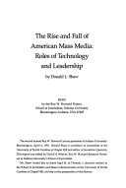
Shaw also observed:
“Historically mass media seem to play the role of Trojan Horse to social change. That seems to be an effect of evolving communication technologies.”
Where social change goes, there shall law and policy inevitably follow.

Slide 29
E. Selling Facebook

Slide 30

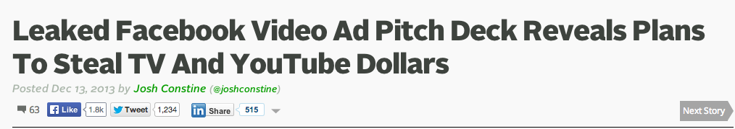
Social Media as Direct Competitor
http://techcrunch.com/2013/12/13/facebook-vs-tv-and-youtube/

Slide 31
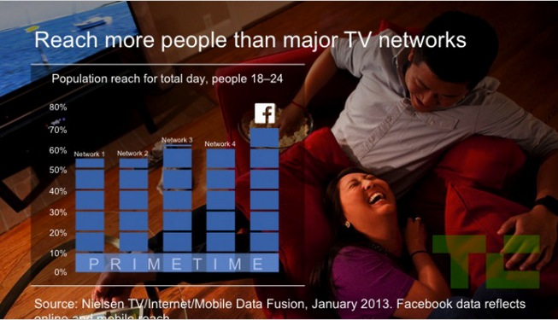
Some sample slides

Slide 32
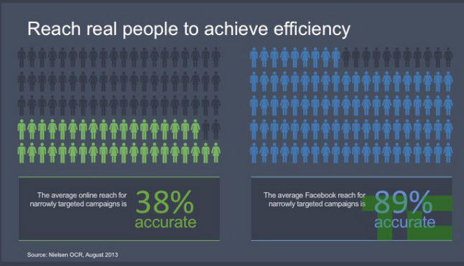

Slide 33
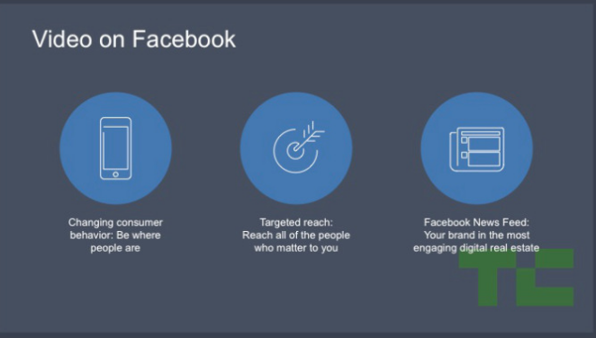

Slide 34
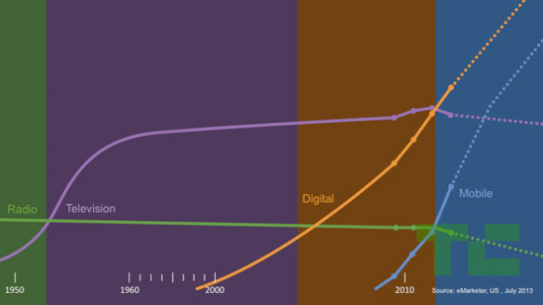
History of time spent on media…
(per Facebook)

Slide 35


Slide 36
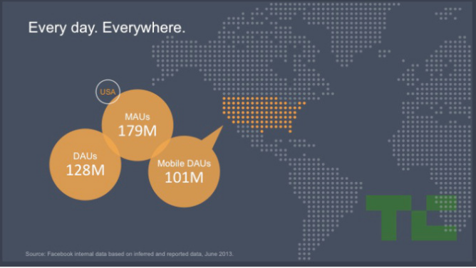

Slide 37
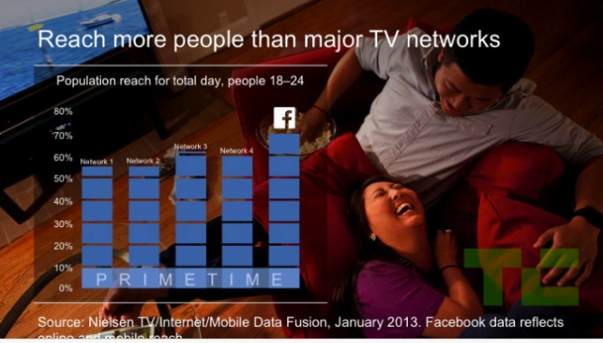

Slide 38
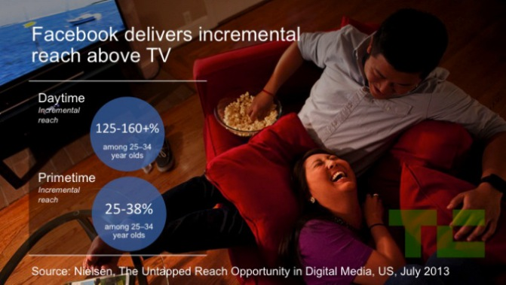

Slide 39
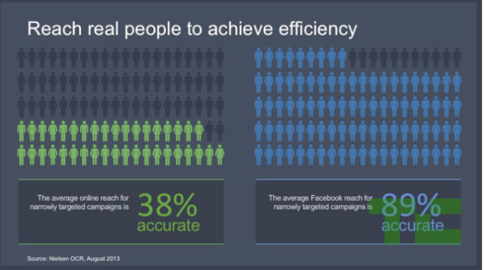

Slide 40


Slide 41
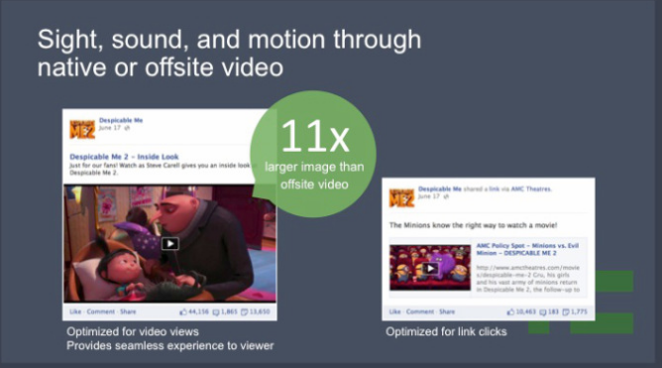

Slide 42
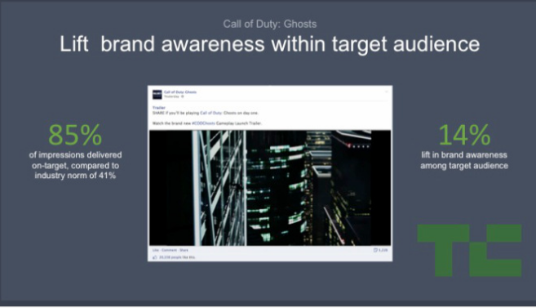

Slide 43
F. A Brief Word About Measurement & Revenue Streams

Slide 44
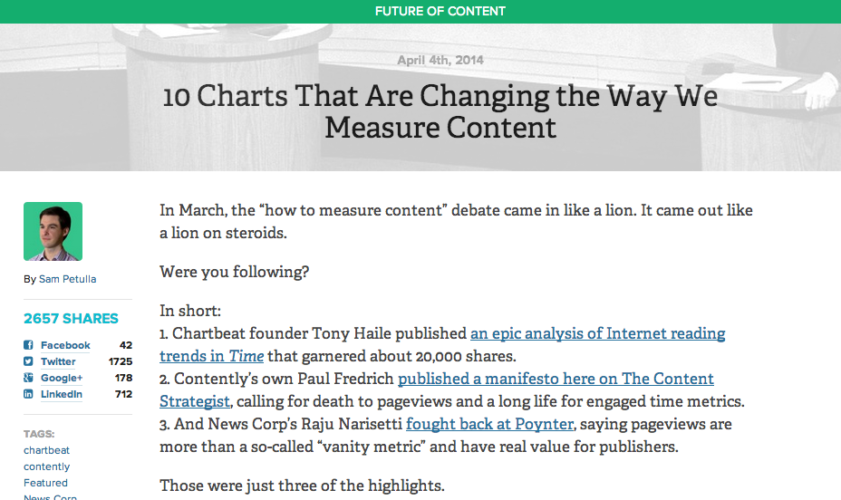
Social media measurement conundrums
http://contently.com/strategist/2014/04/04/10-charts-that-are-changing-the-way-we-measure-content/

Slide 45
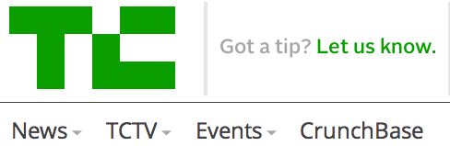
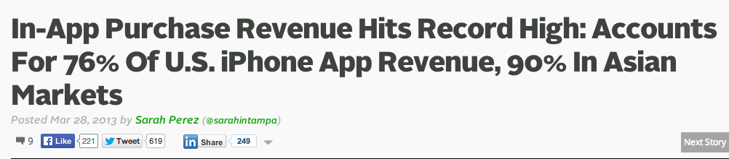
The Growing Revenue Stream
http://techcrunch.com/2013/03/28/in-app-purchase-revenue-hits-record-high-accounts-for-76-of-u-s-iphone-app-revenue-90-in-asian-markets/

Slide 46

But…
http://www.polygon.com/2014/4/9/5597896/study-mobile-app-revenue

Slide 47
Netflix, Big Data
&
Net Neutrality

Slide 48
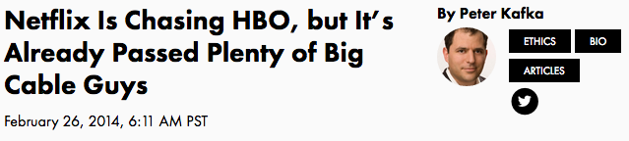


http://recode.net/2014/02/26/netflix-is-chasing-hbo-but-its-already-passed-plenty-of-big-cable-guys/
http://www.digitaltrends.com/movies/will-web-broadcasters-like-netflix-degrade-the-quality-of-tv/#!D24k5

Slide 49
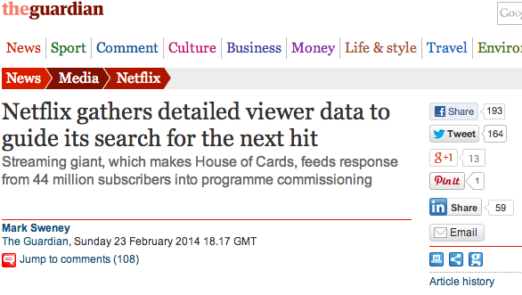
Using “It’s” Data

Slide 50
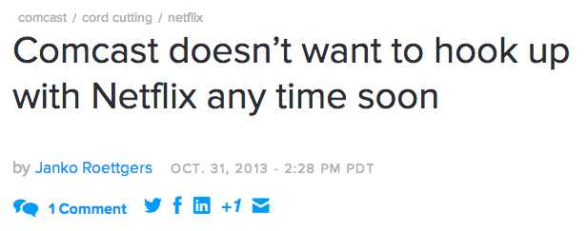
Netflix/Comcast/Net Neutrality Timeline

Slide 51

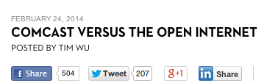
http://www.newyorker.com/online/blogs/elements/2014/02/comcast-versus-the-free-internet.html

Slide 52


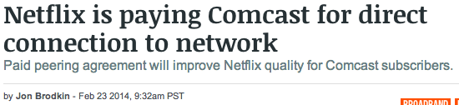
http://arstechnica.com/business/2014/02/netflix-is-paying-comcast-for-direct-connection-to-network-wsj-reports/

Slide 53
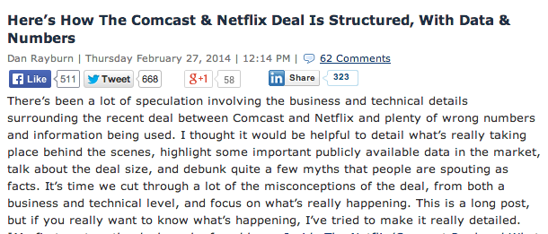
http://blog.streamingmedia.com/2014/02/heres-comcast-netflix-deal-structured-numbers.html

Slide 54
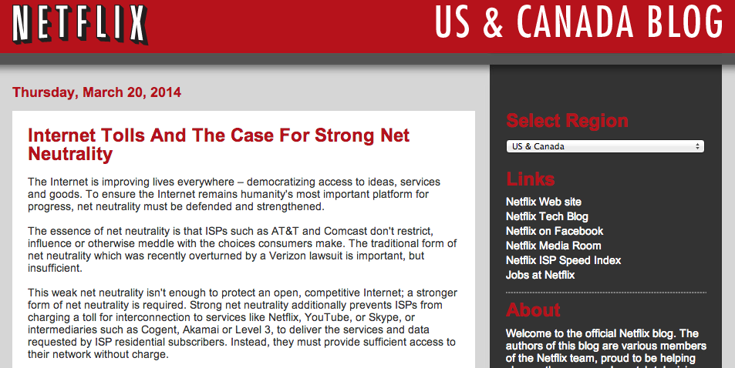
Reed Hasting’s Blog Declaration
http://blog.netflix.com/2014/03/internet-tolls-and-case-for-strong-net.html

Slide 55
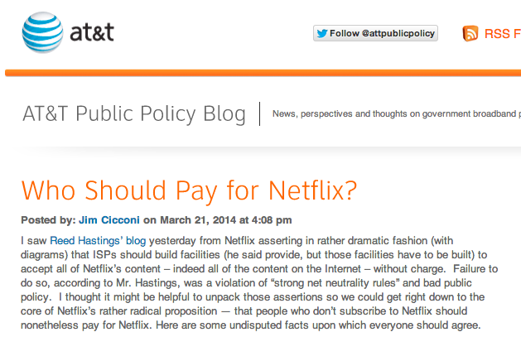
AT&T reply
http://www.attpublicpolicy.com/consumers-2/who-should-pay-for-netflix/

Slide 56
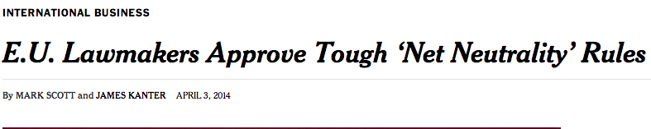

The E.U. Perspective
http://www.nytimes.com/2014/04/04/business/international/eu-lawmakers-approve-tough-net-neutrality-rules.html

Slide 57
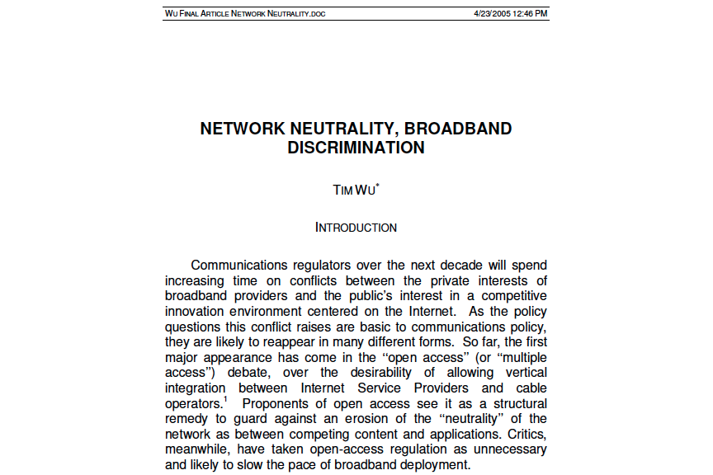
The seminal academic paper
https://papers.ssrn.com/sol3/papers.cfm?abstract_id=388863

Slide 58
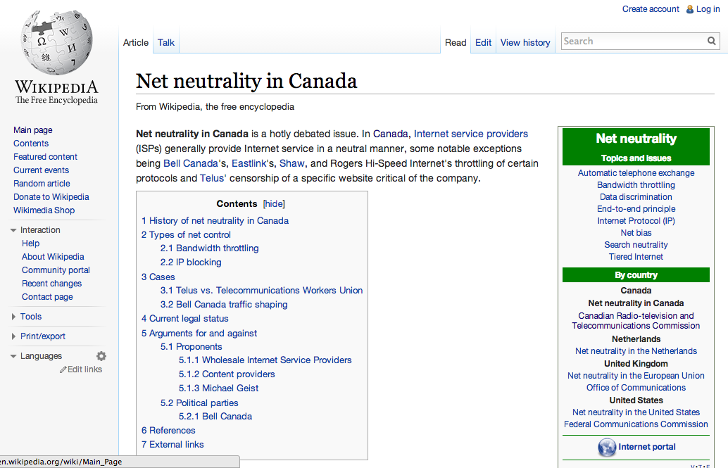
http://en.wikipedia.org/wiki/Net_neutrality_in_Canada

Slide 59
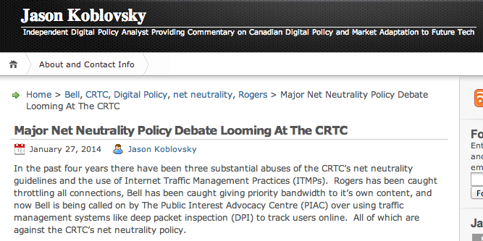
http://jkoblovsky.wordpress.com/2014/01/27/major-net-neutrality-policy-debate-looming-at-the-crtc/

Slide 60
H. Challenges
&
“Solutions”

Slide 61
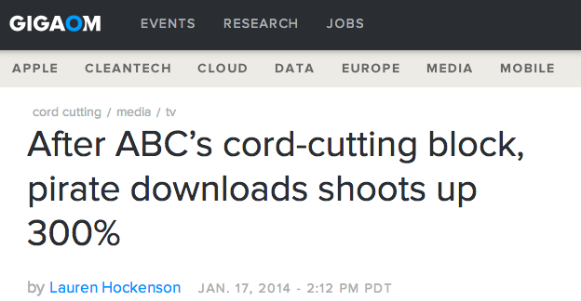

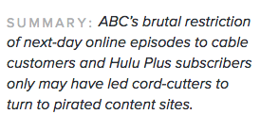
1.“Piracy”

Slide 62
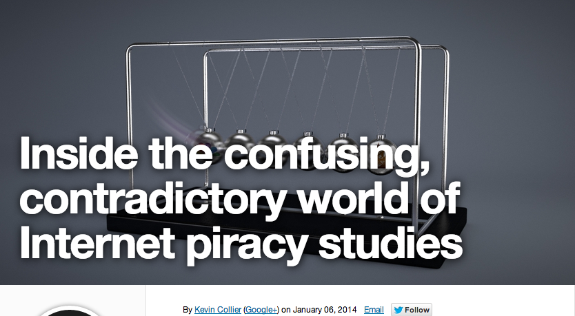
http://www.dailydot.com/politics/piracy-studies-contradictory-paid-for/

Slide 63
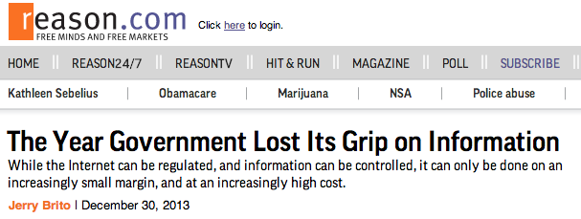
2. Problems with “Solutions”
a. Post “Snowden” distrust of government & regulators

Slide 64

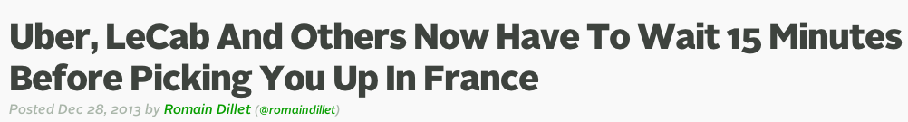
b. In the “face-palm” department..
France legislated that urban transportation services like Le Cab & Uber had to make consumers wait 15 minutes before letting them in the car in order to “protect” traditional taxis…

Slide 65


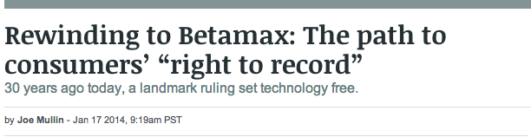
3. Copyright Literalism:
Inadequate for Canada?

Slide 66
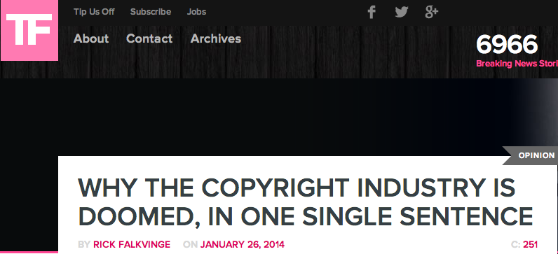
“The very concept of a business around the copyright monopoly revolves around the ability to prevent people from telling each other interesting things.” — Scary Devil Monastery

Slide 67
In this context: SCC “User” paradigm shifts
August 2012 “Copyright Pentalogy” & previous cases
Moving from fair dealing as an exception to copyright infringement towards proactive “User Rights”
Right to Link (Crookes v. Newton)
Right to longer iTunes previews
Tech Neutrality
Fair dealing is to be assessed from the point of view of the purchaser/user
“Research” need not be associated with traditional intellectual pursuits
See: “Reflections on the Supreme Court of Canada 2012 Copyright Decisions” (IP Osgoode) Nov. 29,2012
http://www.iposgoode.ca/2012/11/ip-osgoode-speaker-series-the-honourable-mr-justice-marshall-rothstein-%E2%80%93-reflections-on-the-supreme-court-of-canada-2012-copyright-decisions/

Slide 68

SCC Penatalogy Quotes
Abella J. for the majority in Alberta (Education)
v. Canadian Copyright Licensing Agency (Access
Copyright) 2012 SCC 37:
“…fair dealing is a “user’s right”, and the
relevant perspective when considering whether the
dealing is for an allowable purpose…is that of the
user…”
Abella J. for the Court in Society of composers,
Authors and Music Publishers of Canada v. Bell
Canada 2012 SCC 36:
“Further, given the ease and magnitude with which
digital works are disseminated over the Internet,
focusing on the “aggregate” amount of the dealing in
cases involving digital works could well lead to
disproportionate findings of unfairness when compared
with non-digital works.”
See also: “Copyright Fair Use Cases of the United States Supreme Court”
http://www.ipwatchdog.com/2012/10/05/copyright-fair-use-cases-of-the-united-states-supreme-court/id=26225/

Slide 69
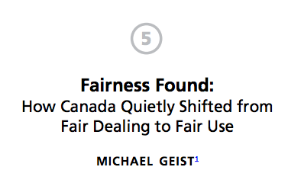
Homework…
From “The Copyright Pentalogy:How the Supreme Court of Canada Shook the Foundations of Canadian Copyright Law, M. Geist Ed., U of Ottawa Press, 201
http://www.press.uottawa.ca/sites/default/files/9780776620848_5.pdf

Slide 70
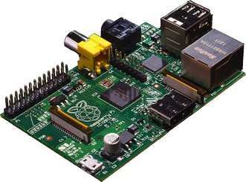
‘Pentalogy’ as harbinger..
User’s Rights
Creator’s Rights:
Same thing?
(individual rights
& responsibilities)

Slide 71
Don’t Forget:
Non-commercial User-generated Content, S.29.21 Copyright Act
Non-commercial user-generated content
29.21 (1) It is not an infringement of copyright for an individual to use
an existing work or other subject-matter or copy of one, which has been
published or otherwise made available to the public, in the creation of a
new work or other subject-matter in which copyright subsists and for the
individual — or, with the individual’s authorization, a member of their
household — to use the new work or other subject-matter or to authorize an
intermediary to disseminate it, if
(a) the use of, or the authorization to disseminate, the new work
or other subject-matter is done solely for non-commercial purposes;
(b) the source — and, if given in the source, the name of the author,
performer, maker or broadcaster — of the existing work or other subject-
matter or copy of it are mentioned, if it is reasonable in the
circumstances to do so;
(c) the individual had reasonable grounds to believe that the existing work
or other subject-matter or copy of it, as the case may be, was not
infringing copyright; and
(d) the use of, or the authorization to disseminate, the new work or other
subject-matter does not have a substantial adverse effect, financial or
otherwise, on the exploitation or potential exploitation of the existing
work or other subject-matter — or copy of it — or on an existing or
potential market for it, including that the new work or other subject-
matter is not a substitute for the existing one.

Slide 72

USA UNRESOLVED CHALLENGES
“Judges as Bad Reviewers:
Fair Use and
Epistemological Humility”
Rebecca Tushnet,
Georgetown University Law
Center
“…the future of fair use as
a formal doctrine in the
United States depends on
whether judges act like bad
reviewers on Amazon.com, or
whether they behave
differently in interpreting
challenged works than they do
in almost every other aspect
of judging.”

Slide 73

+ a weird turn
http://tushnet.blogspot.ca/2014/03/my-long-sad-garcia-v-google-po

Slide 74
I. Back-lashing

Slide 75

BACKLASH 1
http://www.wired.com/2014/01/internet-companies-care-fair-use/

Slide 76

BACKLASH 2

Slide 77

And the unkindest cut of all

Slide 78



Are Legal Responses Useful?
“15 Technologies The Legacy Content Companies Have Sued In The Past 15 Years” http://www.techdirt.com/blog/innovation/articles/20131008/11072724796/15-technologies-legacy-content-companies-have-sued-past-15-years.shtml

Slide 79

Reversing the lawsuit strategy:
Prof. Lessig’s Victory…
http://arstechnica.com/tech-policy/2014/02/lawrence-lessig-wins-damages-after-rights-holder-demands-youtube-takedown/

Slide 80

The plague of “trolls”
http://papers.ssrn.com/sol3/Papers.cfm?abstract_id=2404950

Slide 81


http://www.michaelgeist.ca/content/view/7077/125/

Slide 82


Beware double meaning of “troll”
http://www.geekosystem.com/trolls-are-terrible/

Slide 83
J. Some Answers For
‘Conventional’ Media

Slide 84


Innovative response to Social Media?
http://www.bjp-online.com/2014/03/getty-images-makes-35-million-images-free-in-fight-against-copyright-infringement/

Slide 85


Conventional strategies…
It will be cheaper
2. Limited channel lineup
3. Organized by subject
4. Personal subscriptions
Viewable on any screen
5. A better remote
6. No more switching inputs
6. Netflix is just another channel
7. HBO gets more accessible
8. On-demand that’s not awful
9. New channels emerging all the time
10. (Internet TV is) not as reliable
11. (Internet TV is) Not as cheap
http://qz.com/184378/the-future-of-tv-is-coming-into-focus-and-looks-pretty-great/

Slide 86

http://www.mediapost.com/publications/article/218961/why-tv-dollars-wont-go-online-in-10-words.html

Slide 87



http://www.wired.co.uk/magazine/archive/2013/12/wired-world-2014/tv-ads-that-know-you-intimately
http://recode.net/2014/04/06/nielsens-ability-to-measure-mobile-tv-viewing-takes-step-forward/

Slide 88

http://pando.com/2014/03/03/tv-remains-the-10000-pound-gorilla-in-the-advertising-market/

Slide 89

The Really Conventional Strategy
(which may not work)

Slide 90
Another Possible Strategy?:
Embrace User/Consumer Privacy
Broadcasters have a long and proud history (notably in their newsrooms) of legal resistance to search warrants, prior restraints and the like…
Does this represent a profound vulnerability of social media/digital media that “conventional” media might take advantage of?

Slide 91


An Example

Slide 92


Example 2:
http://scgnews.com/how-big-tech-companies-are-using-pr-techniques-to-counter-the-effects-of-nsa-scandal

Slide 93

But avoid the pitfall
http://www.scientificamerican.com/article/when-big-data-marketing-becomes-stalking/

Slide 94
The most unorthodox of ideas… the oddest of ironies
Would broadcaster/cable-
co/distributers be best
advised to work with
Netflix?
WHY IN THE WORLD?

Slide 95

Consider the application of…
https://scc-csc.lexum.com/scc-csc/scc-csc/en/item/2586/index.do

Slide 96
Simply put…
What are the consequences if
Netflix is seen as part of the
“Broadcasting System”?

Slide 97

High Profile but Irrelevant
(in Canada)

Slide 98


Why irrelevant?
http://arstechnica.com/tech-policy/2012/08/why-johnny-cant-stream-how-video-copyright-went-insane/

Slide 99
K. Future Challenges

Slide 100


1. Social Media meets The Internet of Things: Will this be even more competition for traditional media & entertainment?

Slide 101


Slide 102

2. Facebook + Virtual Reality
http://www.nytimes.com/2014/04/03/technology/personaltech/virtual-reality-perfect-for-an-immersive-society.html?_r=0

Slide 103

L. The Challenge of
“The Law”

Slide 104


A Common Question:
Why is it that law inevitably lags technology?

Slide 105

The Law often seems behind,
disconnected and confused,
incapable or too slow to do
Justice..
“[s]tealing is stealing whether you use a computer command
or a crowbar, and whether you take documents, data or
dollars. It is equally harmful to the victim whether you
sell what you have stolen or give it away.”*
*The United States Attorney’s Office, District of Massachusetts, Press Release, “Alleged Hacker Charged with
Stealing over Four Million Documents from MIT Network” (19 July 2011), online: <
http://www.justice.gov/usao/ma/news/2011/July/SwartzAaronPR.html>

Slide 106
“I may be one of very few people in this room who actually makes his living personally by creating what these gentlemen are pleased to call “intellectual property.” I don’t regard my expression as a form of property. Property is something that can be taken from me. If I don’t have it, somebody else does.
Expression is not like that. The notion that expression is like that is entirely a consequence of taking a system of expression and transporting it around, which was necessary before there was the internet, which has the capacity to do this infinitely at almost no cost.”
John Perry Barlow, May 2011

Slide 107
Consider the possibility...
…that Law (& Justice) can never
adequately resolve
communications based issues
precisely because…
communications memes
proactively define the future
meanings of Justice & the forms
Law will take.
(breathing hard…sweat falling off brow…this can’t
be right…can it?)

Slide 108
More Bravely
Concepts of law & justice do not shape communications technologies nearly as much as they are shaped by the memes and meanings arising from communications technologies.

Slide 109
Technology /Justice (Parallels)?
Before Justice was Revenge
1. Pre-literate => Justice as Retribution
2. Writing Instruments => Justice as
Compensation
3. Printing Press => Justice as Rights
4. Mass Media => Justice as Truth
5. Digital => Justice as Resolution
6. Big Data =>
-----FUTURE----
=> 6. Justice as Boundaries
7. Virtual reality => ???

Slide 110
An explanation?
Art & creativity has pushed & been pushed by technology. Art humanizes. Technology (writing instrument/printing press/media/digital/data) distributes that humanness.
The meaning of "Justice" has become defined and redefined in this context.

Slide 111

Law Is…
Personal in Experience,
General in Application.
Nelson Mandela’s cell

Slide 112
Similarly in the Social Media World…
…all media Is PERSONAL…so……best be very careful about what can really be done with law & policy

Slide 113
Lots of Law at stake:
11. Internet Governance & Surveillance (International Law)
10. Criminal & Obscenity Laws.
9. Taxation/Currency/Gambling (regulatory; quasi-criminal)
8. Misleading promises/advertising, physical or
psychological harm, unfair competition/anti-trust
(consumer protection)
7. Industry self regulation (delegated authority) & medium
specific regulation (constitutional)
Out of the Creation Norms ----------------------------------------------------------
In the Creation (Magic Circle) Ethics (of Originality, Creativity & Expression)
6. Privacy, Defamation & Personality law (tort, IP)
5. EULA/ToS & Contracts (contractual, private)
4. Trademark, Patents & the IP Business
3. Copyright & Users Rights (statutory)
2. Technology (quasi extra-legal)
1. Community (extra-legal)

Slide 114
M. Final Thoughts

Slide 115
Some Questions
1. In a digital world which appears relatively borderless from a social media user/creator/consumer perspective, is being a Canadian creator/broadcaster/distributor less significant then it was?
2. Are we increasingly moving away from “Branded Entertainment” and towards “Branded Audiences”?
3. Moving towards “EXPERIENCES” over “entertainment”
4. Innovation/disruption as a key value?

Slide 116


One more question:
Is It Barter Not Theft (Piracy)
IF
We Are All Creators?

Slide 117

Always include a cat picture

Slide 118
Our Academic Partners

